Slide 1
Introduction to GPU Computing

Slide 2
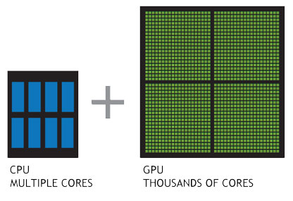
http://www.nvidia.com

Slide 3


CPU:
Small # of super-fast cores
GPU:
Large # of small cores

Slide 4
Terminology
  Host – The CPU and its memory (host memory)
  Device – The GPU and its memory (device memory)

Slide 5
Multiprocessor
SMEM
SMEM
SMEM
…
Global Memory
PCI-Express
CPU Chipset

Slide 6
At its simplest, CUDA C is just C!
Use NVCC to compile
nvcc splits source file into host and device components
  NVIDIA’s compiler handles device functions like kernel()
  Standard host compiler handles host functions like main()
    gcc

Slide 7
__global__ void kernel( void ) {}
int main( void )
{
kernel<<< 1, 1 >>>(); //kernel call
printf( "Hello, World!\n" );
return 0;
}
CUDA C keyword __global__ indicates that a function
Runs on the device
Called from host code

Slide 8
Device done nothing
  1 thread
Host print “hello world”

Slide 9
__global__ void add( int *a, int *b, int *c )
{
*c = *a + *b;
}
int main( void )
{
int a, b, c; // host copies of a, b, c
int *dev_a, *dev_b, *dev_c; // device copies of a, b, c
int size = sizeof( int ); // we need space for an integer
// allocate device copies of a, b, c
cudaMalloc( (void**)&dev_a, size );
cudaMalloc( (void**)&dev_b, size );
cudaMalloc( (void**)&dev_c, size );
// init values
a = 1;
b = 2;

Slide 10
A More Complex Example: main() (cont)
// copy inputs to device
cudaMemcpy( dev_a, &a, size, cudaMemcpyHostToDevice );
cudaMemcpy( dev_b, &b, size, cudaMemcpyHostToDevice );
// launch add() kernel on GPU, passing parameters
add<<< 1, 1 >>>( dev_a, dev_b, dev_c );
// copy device result back to host copy of c
cudaMemcpy( &c, dev_c, size, cudaMemcpyDeviceToHost );
cudaFree( dev_a );
cudaFree( dev_b );
cudaFree( dev_c );
return 0;
}

Slide 11
add<<< 1, 1 >>>( dev_a, dev_b, dev_c );
add<<< N, 1 >>>( dev_a, dev_b, dev_c );
  Instead of executing add() once, add() executed N times in parallel

Slide 12
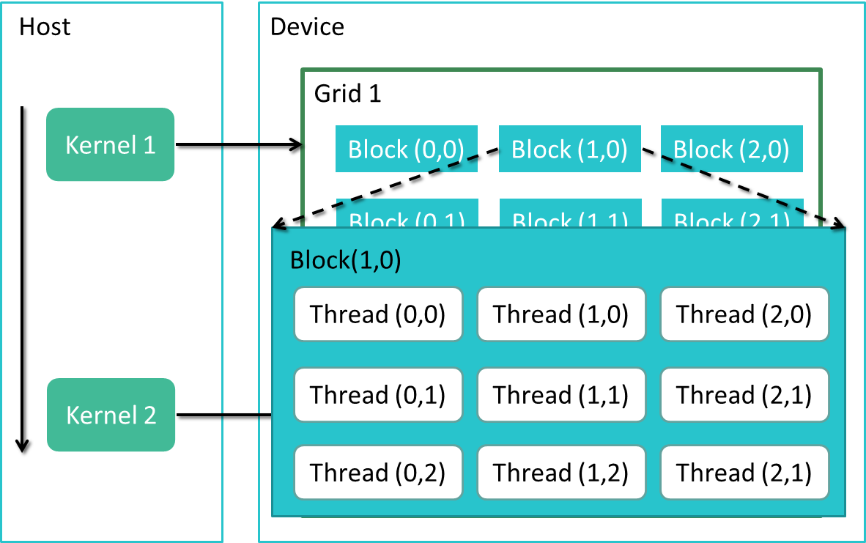

Slide 13
We write this code:
__global__ void add( int *a, int *b, int *c )
{
c[blockIdx.x] = a[blockIdx.x] + b[blockIdx.x];
}
This is what runs in parallel on the device:
Block 0
c[0] = a[0] + b[0];
Block 1
c[1] = a[1] + b[1];
Block 2
c[2] = a[2] + b[2];
Block 3
c[3] = a[3] + b[3];

Slide 14
Threads
A block can be split into parallel thread
__global__ void add( int *a, int *b, int *c )
{
int index = threadIdx.x + blockIdx.x * blockDim.x;
c[index] = a[index] + b[index];
}

Slide 15
Install CUDA on your computer
http://docs.nvidia.com/cuda/cuda-getting-started-guide-for-microsoft-windows/
http://docs.nvidia.com/cuda/cuda-getting-started-guide-for-mac-os-x/index.html
http://docs.nvidia.com/cuda/cuda-getting-started-guide-for-linux/index.html
Check out CUDA-Enabled GPUs:
  https://developer.nvidia.com/cuda-gpus

Slide 16
To Learn More CUDA C
Check out CUDA by Example
Parallel Programming in CUDA C
Thread Cooperation
Constant Memory and Events
Texture Memory
Graphics Interoperability
Atomics
Streams
CUDA C on Multiple GPUs
Other CUDA Resources
http://developer.nvidia.com/object/cuda-by-example.html

